Slide 1
The Cellular Concept

Slide 2
Cellular Concept
The limited capacity of the first mobile radio-telephone services was related to the spectrum used…not much sharing and a lot of bandwidth dedicated to a single call.
  good coverage
  interference: impossible to reuse the same frequency
The cellular concept addressed many of the shortcomings of the first mobile telephones
  Frequency reuse
  Wasted spectrum allocated to a single user
In 1968, Bell Labs proposed the cellular telephony concept to the FCC
It was approved and then the work began!
  FCC allocated spectrum (took away TV UHF channels 70-83) in the 825-845 MHz and 870-890 MHz bands

Slide 3
Cellular Concept
developed by Bell Labs 1960’s-70’s
areas divided into cells
a system approach, no major technological changes
a few hundred meters in some cities, 10s km at country side
each served by base station with lower power transmitter
each gets portion of total number of channels
neighboring cells assigned different groups of channels, interference minimized
hexagon geometry cell shape

Slide 4
Principles of Cellular Networks
Underlying technology for mobile phones, personal communication systems, wireless networking etc.
Developed for mobile radio telephone
  Replace high power transmitter/receiver systems
    Typical support for 25 channels over 80km
  Use lower power, shorter range, more transmitters

Slide 5
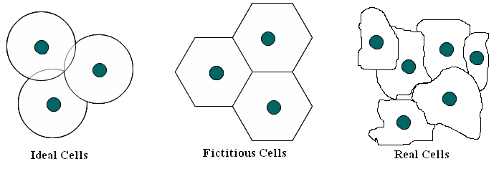
What is a Cell?
Cell is the Basic Union in The System
  defined as the area where radio coverage is given by one base station.
A cell has one or several frequencies, depending on traffic load.
  Fundamental idea: Frequencies are reused, but not in neighboring cells due to interference.
Prof. Dr.-Ing. Jochen H. Schiller www.jochenschiller.de MC - 2009
Notes:
Central ideas of cellular systems
Small coverage areas (cells)
Frequency reuse
Handoff (not all mobile calls can be completed within a single cell)
Cell splitting to increase capacity
Cell radius depends on the propagation conditions and the network design:
• ranges from few meters for indoor or microcellular networks
to 10s of kilometers of rural service areas
A basestation/network provides service for users by coordinating access (time slots, frequency channels, or codes) to channels
Bandwidth (channels) is (are) split amongst a group of cells – called cluster
• Cluster is repeated to cover a wider geographical area

Slide 6
Cellular Network Organization
Multiple low power transmitters
  100w or less
Area divided into cells
  Each with own antenna
  Each with own range of frequencies
  Served by base station
    Transmitter, receiver, control unit
  Adjacent cells on different frequencies to avoid crosstalk

Slide 7

Shape of Cells
Square
  Width d cell has four neighbors at distance d and four at distance d
  Better if all adjacent antennas equidistant
    Simplifies choosing and switching to new antenna
Hexagon
  Provides equidistant antennas
  Radius defined as radius of circum-circle
    Distance from center to vertex equals length of side
  Distance between centers of cells with radius R is d
  Not always precise hexagons
    Topographical limitations
    Local signal propagation conditions
    Location of antennas

Slide 8
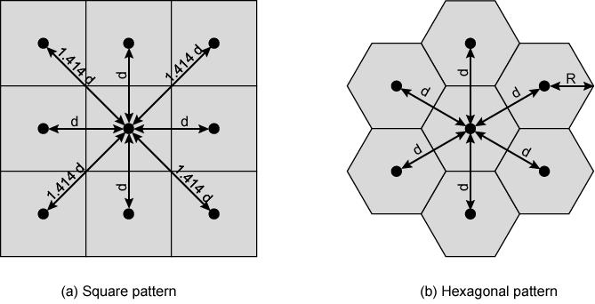
Cellular Geometries

Slide 9
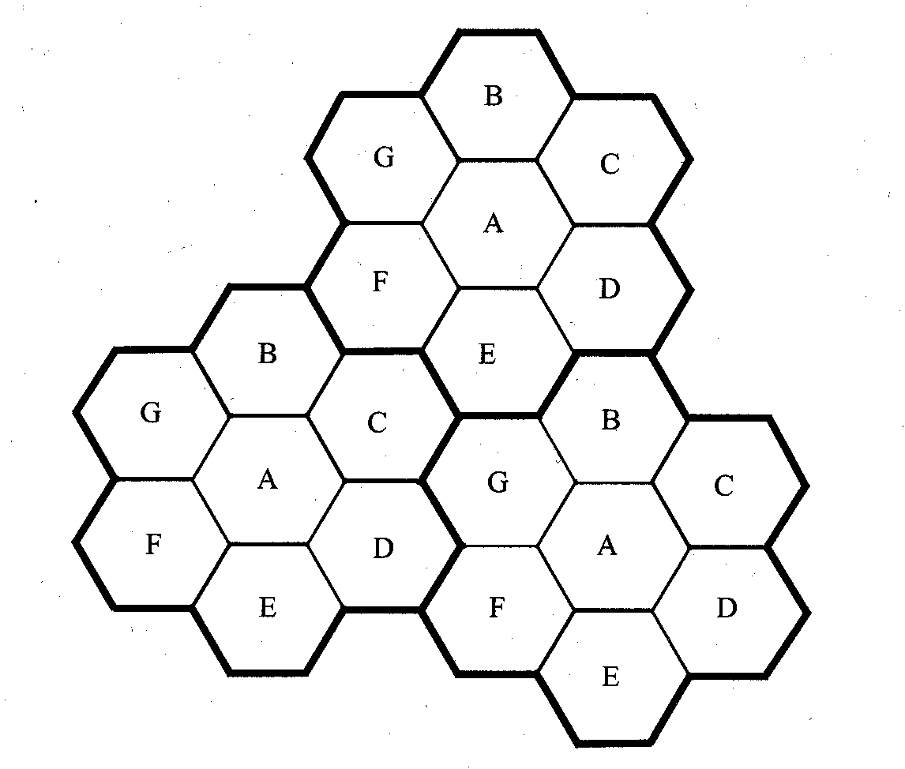
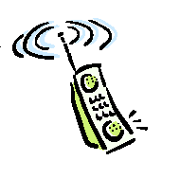
Frequency Reuse
Solves the problem of spectral congestion and user capacity.
Offer very high capacity in a limited spectrum without major technological changes.
Reuse of radio channel in different cells.
Enable a fix number of channels to serve an arbitrarily large number of users by reusing the channel throughout the coverage region.

Slide 10
Frequency Reuse
Each cellular base station is allocated a group of radio channels within a small geographic area called a cell.
Neighboring cells are assigned different channel groups.
By limiting the coverage area to within the boundary of the cell, the channel groups may be reused to cover different cells.
Keep interference levels within tolerable limits.
Frequency reuse or frequency planning
seven groups of channel from A to G
footprint of a cell - actual radio coverage
omni-directional antenna v.s. directional antenna

Slide 11



Consider a cellular system which has a total of S duplex channels.
Each cell is allocated a group of k channels, .
The S channels are divided among N cells.
The total number of available radio channels
The N cells which use the complete set of channels is called cluster.
The cluster can be repeated M times within the system. The total number of channels, C, is used as a measure of capacity
The capacity is directly proportional to the number
of replication M.
The cluster size, N, is typically equal to 4, 7, or 12.
Small N is desirable to maximize capacity.
Each cell has S/N frequencies
For AMPS system S=395, N=7 giving k=57 frequencies
per cell on average

Slide 12
Frequency Reuse
Power of base transceiver controlled
  Allow communications within cell on given frequency
  Limit escaping power to adjacent cells
  Allow re-use of frequencies in nearby cells
  Use same frequency for multiple conversations
  10 – 60 frequencies per cell
E.g.
  N cells all using same number of frequencies
  K total number of frequencies used in systems
  Each cell has K/N frequencies
  Advanced Mobile Phone Service (AMPS) K=395, N=7 giving 57 frequencies per cell on average

Slide 13
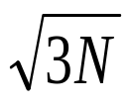

Characterizing Frequency Reuse
D = minimum distance between centers of cells that use the same band of frequencies (called cochannels)
R = radius of a cell
d = distance between centers of adjacent cells
N = number of cells in repetitious pattern
  Reuse factor
  Each cell in pattern uses unique band of frequencies
Hexagonal cell pattern, following values of N possible
  N = I² + J² + (I x J), I, J = 0, 1, 2, 3, …
Possible values of N are 1, 3, 4, 7, 9, 12, 13, 16, 19, 21, …
D/R=
D/d =

Slide 14
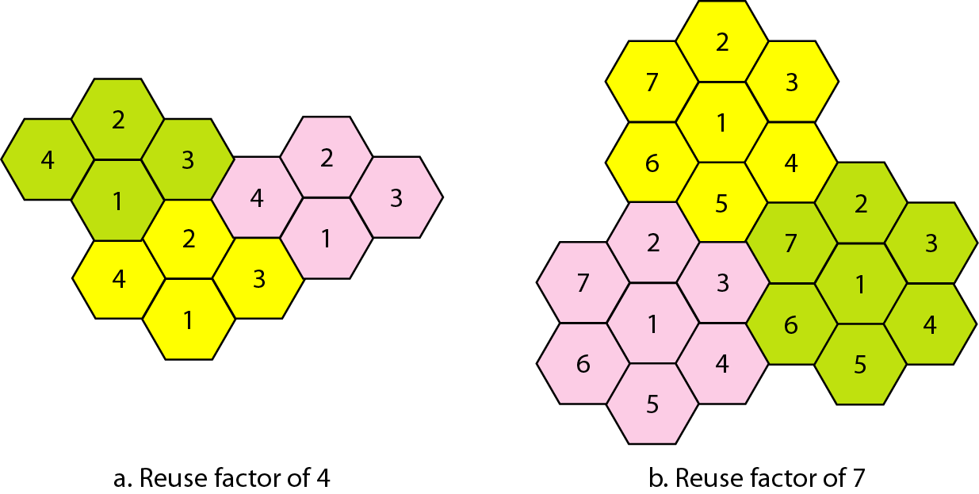
Figure Frequency reuse patterns

Slide 15
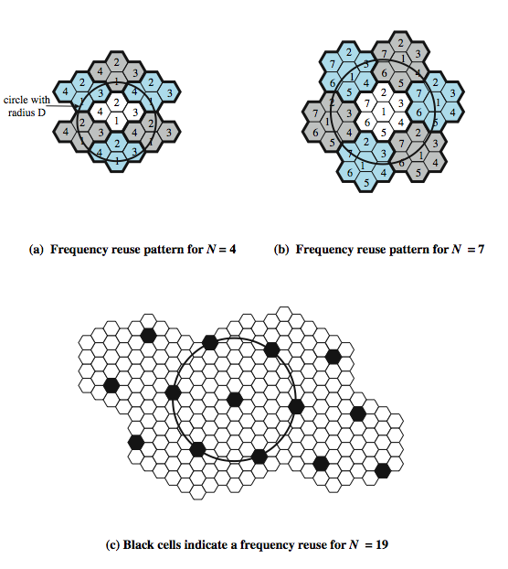
Frequency
Reuse
Patterns
Notes:
Stallings DCC8e Figure 14.2 shows some example reuse patterns. In characterizing frequency reuse, the following parameters are commonly used:
D = minimum distance between centers of cells that use the same band of frequencies (called cochannels)
R = radius of a cell
d = distance between centers of adjacent cells (d = R)
N = number of cells in repetitious pattern (reuse factor), each cell in pattern uses a unique band of frequencies.
With a hexagonal cell pattern, the following values of N possible
N = I² + J² + (I x J), I, J = 0, 1, 2, 3, …
Possible values of N are 1, 3, 4, 7, 9, 12, 13, 16, 19, 21, etc

Slide 16

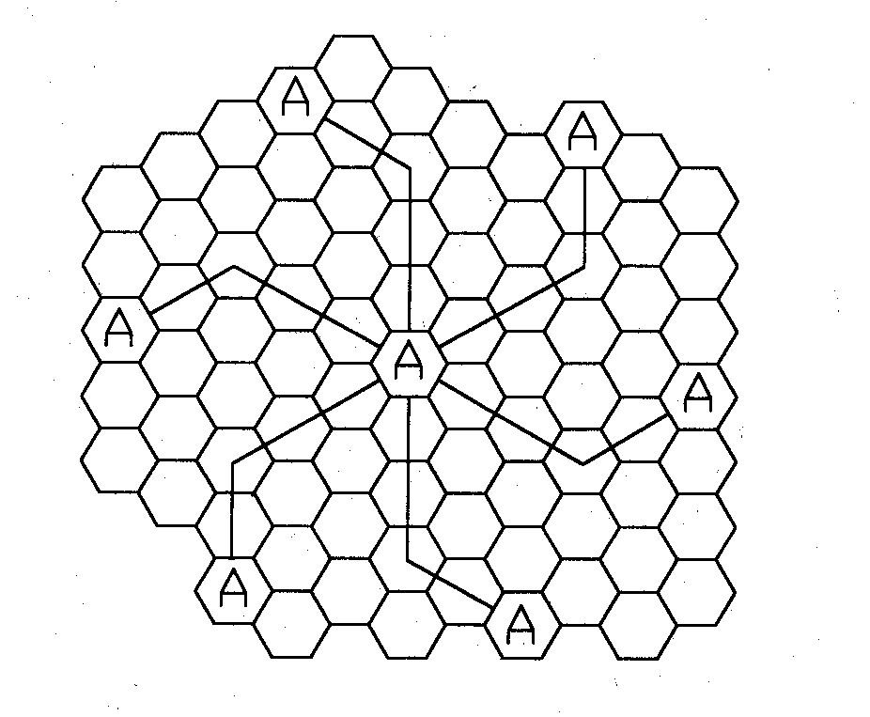
Hexagonal geometry has
  exactly six equidistance neighbors
  the lines joining the centers of any cell and each of its neighbors are separated by multiples of 60 degrees.
Only certain cluster sizes and cell layout are possible.
The number of cells per cluster, N, can only have values which satisfy
Co-channel neighbors of a particular cell, ex, i=3 and j=2.

Slide 17
To find the nearest co-channel neighbor of a particular cell, one must do the following:
move i cells along any chain of hexagons and then
turn 60 degrees counter-clockwise and move j cells.

Slide 18
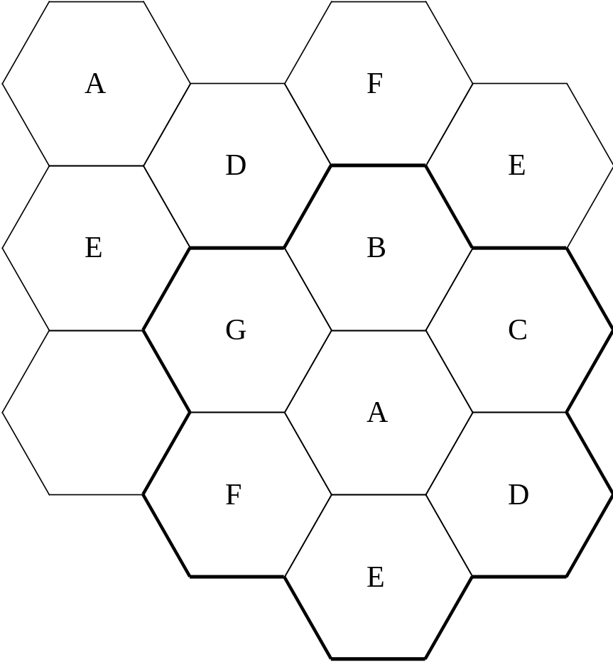
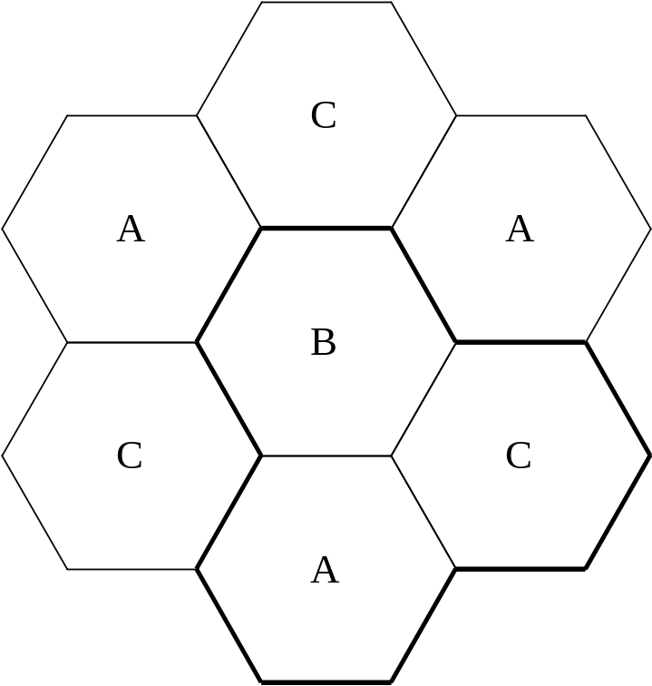
The factor N is called the cluster size and is given
N=i²+ij+j²

Slide 19
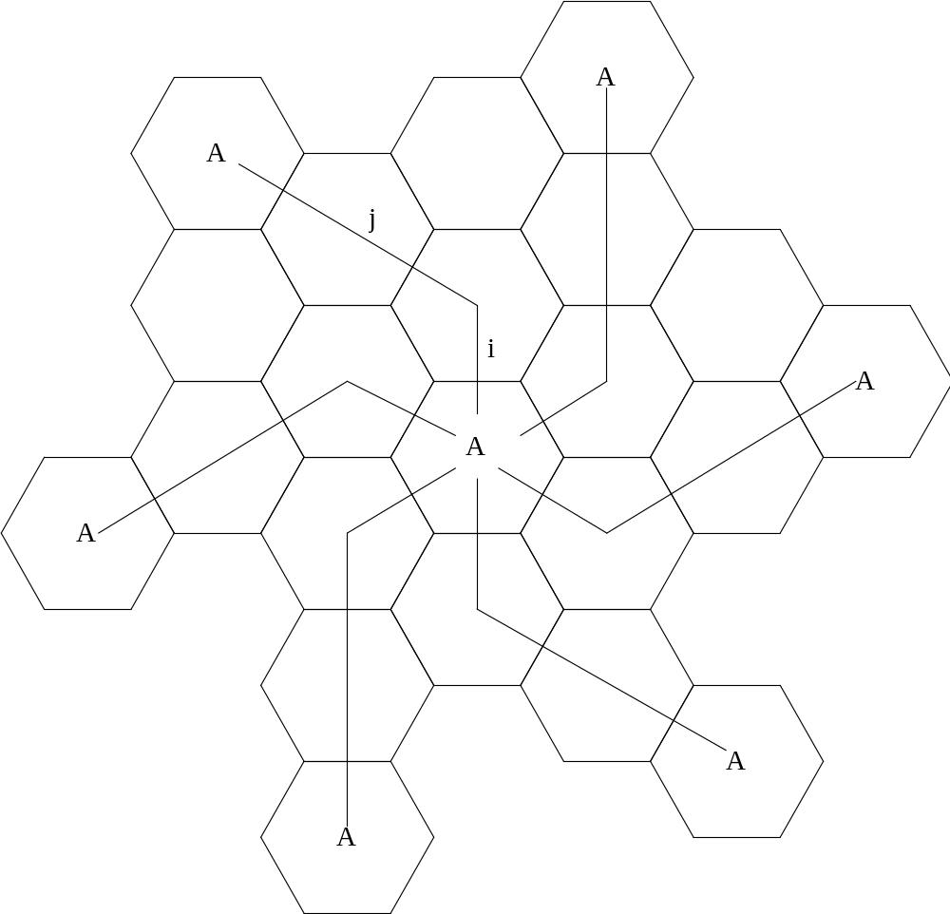
i=1, j=2 , N=1+2+4=7

Slide 20
R
d
3
3
6
1
D
6
1
4
4
7
2
7
2
5
3
5
3
6
1
3
6
1
4
6
1
4
7
2
4
7
2
5
7
2
5
5

Slide 21
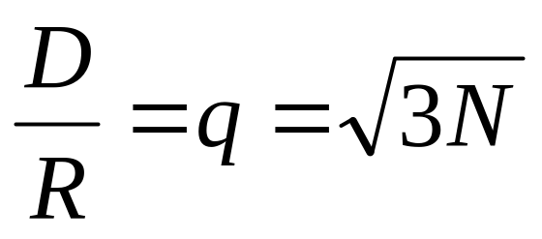
Co-channel Reuse Ratio : q
Assuming hexagonal shape cells of equal size
where:
D: Distance at which the same frequency can be reused
R: Radius of the cell
q: co-channel Reuse ratio
N: Cluster size

Slide 22
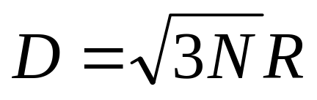
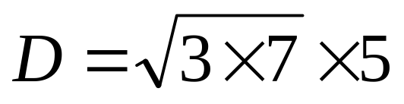
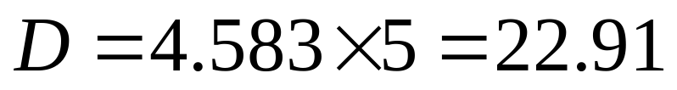
Example
For N = 7 and R 5 km
The minimum distance at which the same frequency can be reused is approximately 4.6 times R, which is in this case 22.91 km

Slide 23
Channel Assignment Strategies
Frequency reuse scheme
  increases capacity
  minimize interference
Channel assignment strategy
  fixed channel allocation
  dynamic channel allocation
  Borrowing channel allocation
Fixed channel assignment
  each cell is allocated a predetermined set of voice channel
  any new call attempt can only be served by the unused channels
  the call will be blocked if all channels in that cell are occupied
Dynamic channel assignment
  channels are not allocated to cells permanently.
  allocate channels based on request.
  reduce the likelihood of blocking, increase capacity.

Slide 24
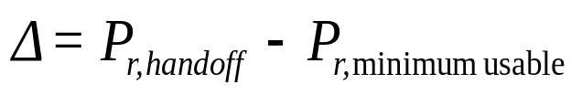

Handoff Strategies
When a mobile moves into a different cell while a conversation is in progress, the MSC automatically transfers the call to a new channel belonging to the new base station.
Handoff operation
  identifying a new base station
  re-allocating the voice and control channels with the new base station.
Handoff Threshold
  Minimum usable signal for acceptable voice quality (-90dBm to -100dBm)
  Handoff margin cannot be too large or too small.
  If is too large, unnecessary handoffs burden the MSC
  If is too small, there may be insufficient time to complete handoff before a call is lost.

Slide 25
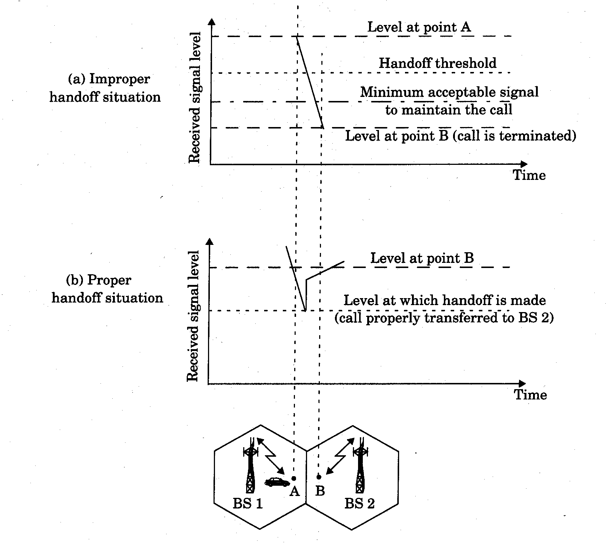

Slide 26
Handoff must ensure that the drop in the measured signal is not due to momentary fading and that the mobile is actually moving away from the serving base station.
Running average measurement of signal strength should be optimized so that unnecessary handoffs are avoided.
  Depends on the speed at which the vehicle is moving.
  Steep short term average -> the hand off should be made quickly
  The speed can be estimated from the statistics of the received short-term fading signal at the base station
Dwell time: the time over which a call may be maintained within a cell without handoff.
Dwell time depends on
  propagation
  interference
  distance
  speed

Slide 27
Handoff measurement
  In first generation analog cellular systems, signal strength measurements are made by the base station and supervised by the MSC.
  In second generation systems (TDMA), handoff decisions are mobile assisted, called mobile assisted handoff (MAHO)
Intersystem handoff: If a mobile moves from one cellular system to a different cellular system controlled by a different MSC.
Handoff requests is much important than handling a new call.

Slide 28
Handoff for first generation analog cellular systems
  10 secs handoff time
  is in the order of 6 dB to 12 dB
Handoff for second generation cellular systems, e.g., GSM
  1 to 2 seconds handoff time
  mobile assists handoff
  is in the order of 0 dB to 6 dB
  Handoff decisions based on signal strength, co-channel interference, and adjacent channel interference.
IS-95 CDMA spread spectrum cellular system
  Mobiles share the channel in every cell.
  No physical change of channel during handoff
  MSC decides the base station with the best receiving signal as the service station

Slide 29
Increasing Capacity (1)
Add new channels
  Not all channels used to start with
Frequency borrowing
  Taken from adjacent cells by congested cells
  Or assign frequencies dynamically
Cell splitting
  Non-uniform distribution of topography and traffic
  Smaller cells in high use areas
    Original cells 6.5 – 13 km
    1.5 km limit in general
    More frequent handoff
    More base stations

Slide 30
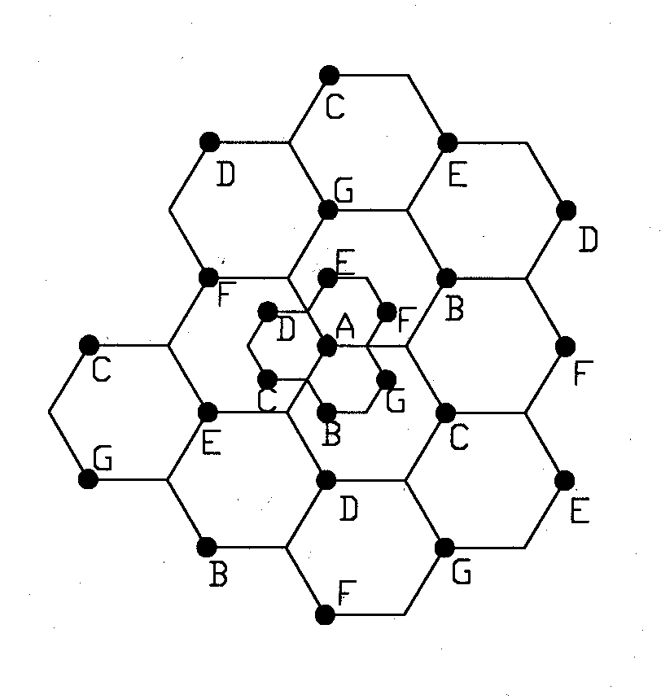
Cell Splitting
Split congested cell into smaller cells.
  Preserve frequency reuse plan.
  Reduce transmission power.
Reduce R to R/2
microcell

Slide 31
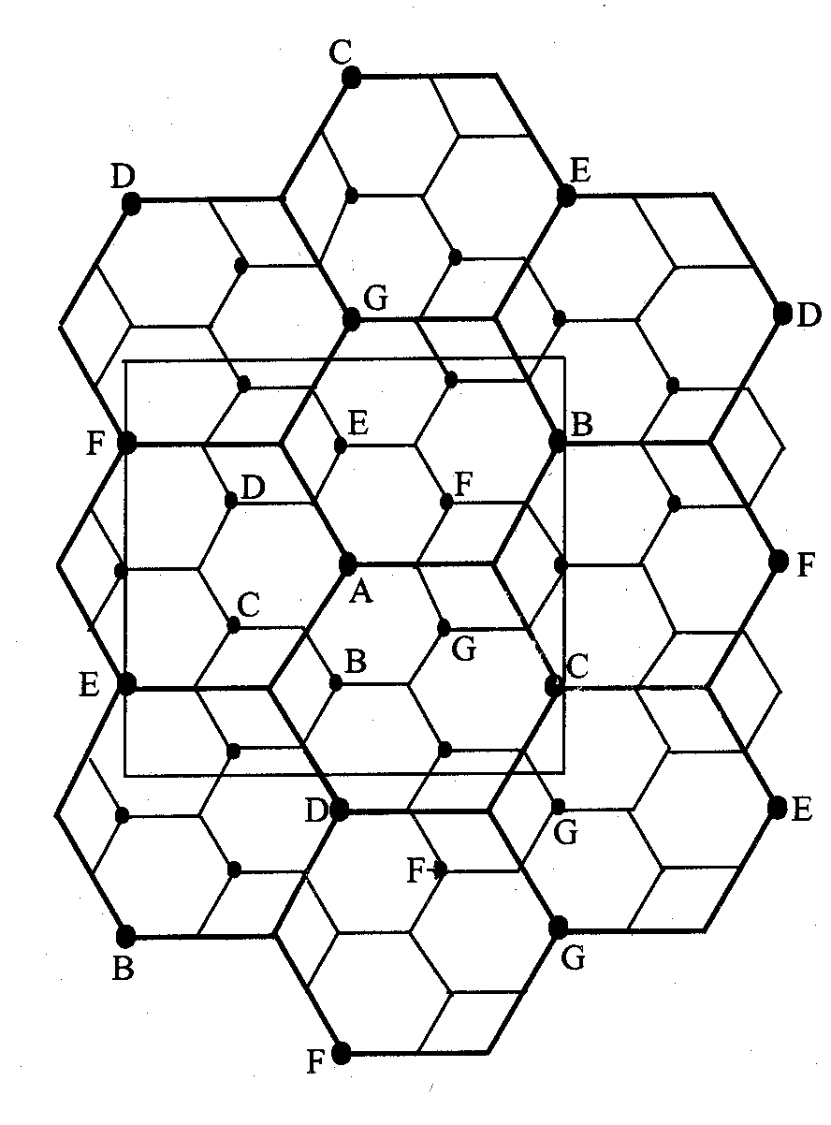
Illustration of cell splitting within a 3 km by 3 km square

Slide 32
Increasing Capacity (2)
Cell Sectoring
  Cell divided into wedge shaped sectors
  3 – 6 sectors per cell
  Each with own channel set
    Subsets of cell’s channels
  Directional antennas
Microcells
  Move antennas from tops of hills and large buildings to tops of small buildings and sides of large buildings
    Even lamp posts
  Form microcells
  Reduced power
  Good for city streets, along roads and inside large buildings

Slide 33
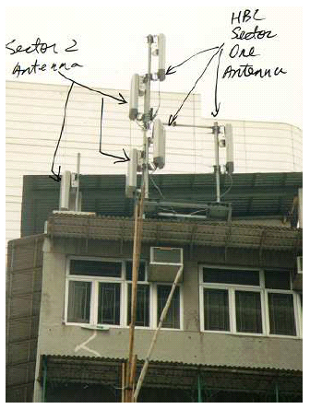
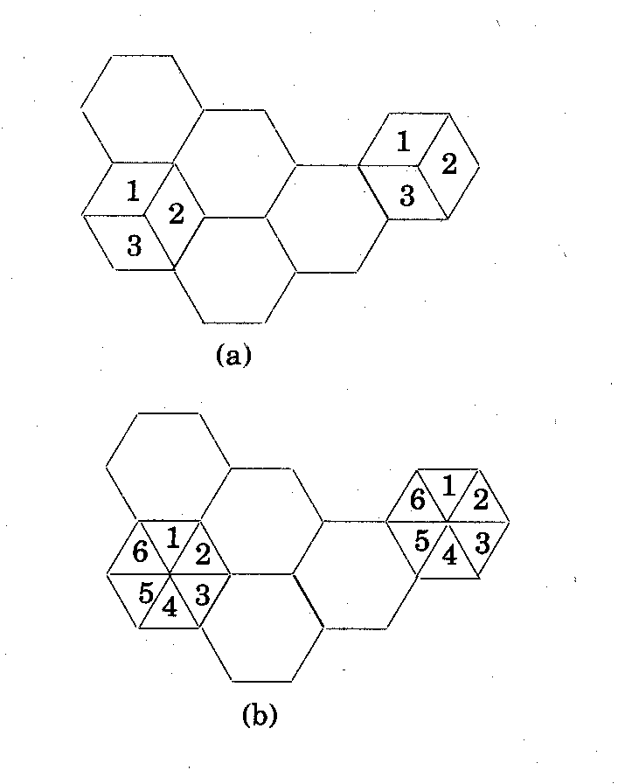
Sectoring
Decrease the co-channel interference and keep the cell radius R unchanged
  Replacing single omni-directional antenna by several directional antennas
  Radiating within a specified sector

Slide 34
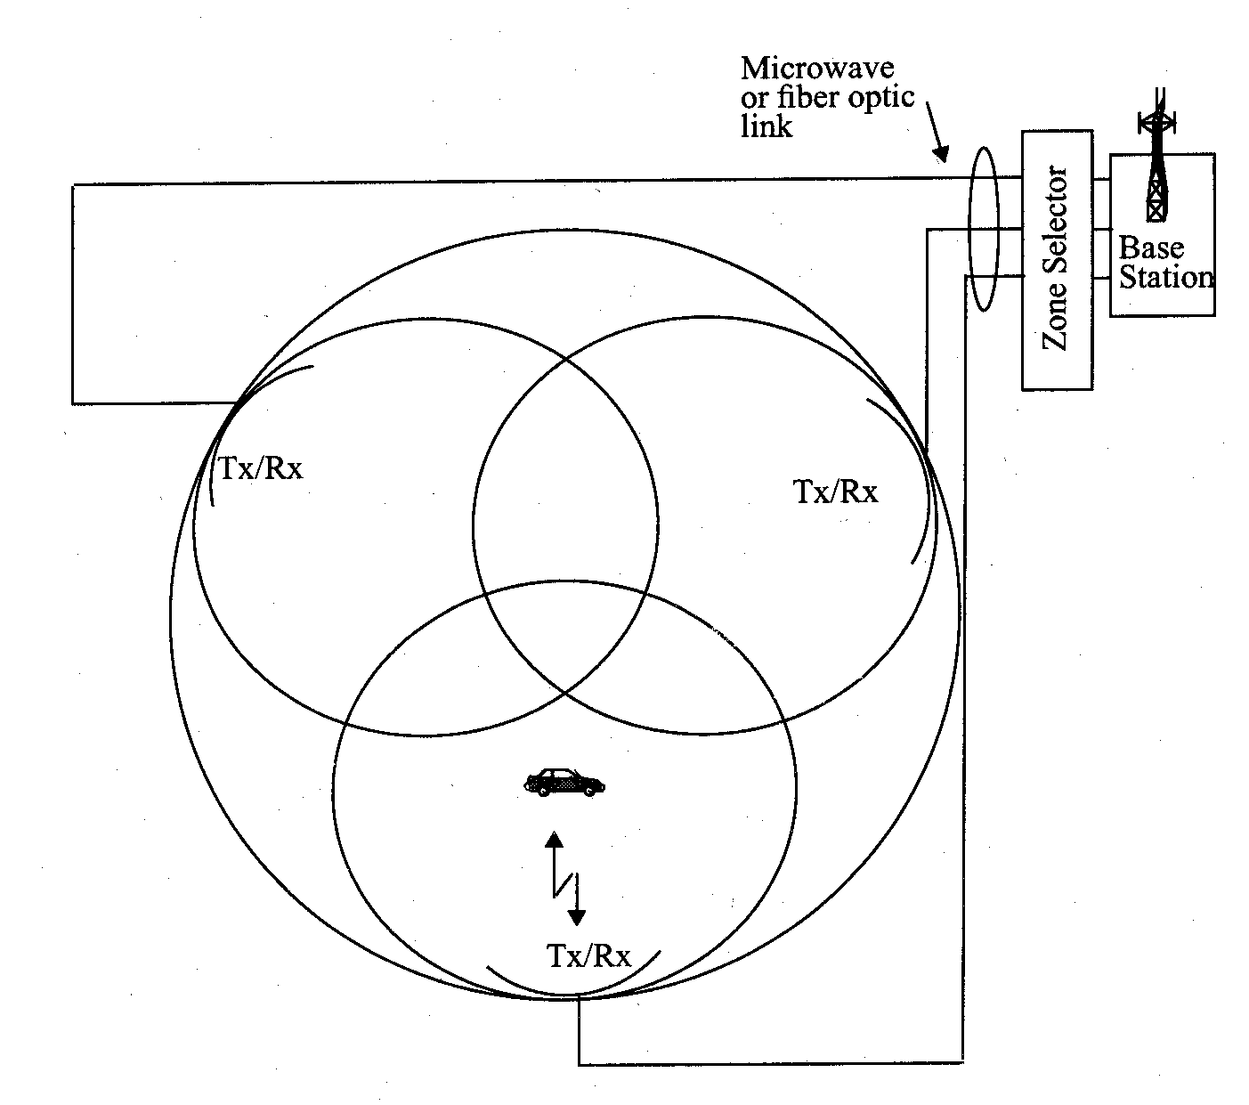
Microcell Zone Concept
Antennas are placed at the outer edges of the cell
Any channel may be assigned to any zone by the base station
Mobile is served by the zone with the strongest signal.
Handoff within a cell
  No channel re-assignment
  Switch the channel to a different zone site
Reduce interference
  Low power transmitters are employed

